Slide 1


Student Registration System SRS
Developed & Implemented By

Slide 2
Phase 1
Developed & Implemented By

Slide 3
Phase 1: Systems Request
Project sponsor: George Washington, Principal of the School of Prosperity
Business Need: This project has been proposed to maintain student records and offer
staff and student resources.
Business Requirements:
The functionality that the system should have is listed below:
Maintain records for students, including grades
Show courses offered by the school
Display the classes available online and face-to-face
Provide online registration for students and allow staff to work online
Business Value:
The goal is to provide easy online access for staff and students. This modern registration system will provide a quick and painless approach to maintaining student records. We expect that this system will assist with high demand of enrollment. This will increase staff productivity and lead to less time in the office.
Conservative estimates of tangible value to the company includes:
$1,500,000 (10 percent of $15,000,000) in increased enrollment from students
$9,605 in saved wages of staff working online
Special Issues or Constraints:
This system will require technical training for all staff and students to adapt to the new system design.
System development will be divided into phases with with a strict adherence to milestone dates.
# | Question | Who to Ask?
1. | Why is an outside entity required for this job? | IT department
2. | How soon do we need this done? | Project Manager
3. | Do we need to maintain the system after implementation? | IT department
4. | What do you expect the feasible cost of this system to be? | George Washington

Slide 4
Phase 1: Systems Request Definition
Non-Functional Requirements
SRS should be Internet-accessible
Students and staff will be able to access the system in real time when connected to the internet.
The users will be able to login to their personal account
Students choose their own classes, from any location
The system will track selected courses for registration/dropping
Allows the staff to work from any location
Staff can login with when away from the office
Access to staff login and documents when they are not in the office
Internet connection and a web browser
The system will be optimized for several web browsers, mobile included
System will be available and optimized for Windows and Mac
Notification will show if user is not on a properly optimized web browser or operating system
Performance requirements
Availability to SRS 24 hours a day every day
Once an online session is started, SRS saves changes every few seconds
Privacy and security requirements
Access only available approved users
Student information will only be available to designated school staff
Functional Requirements
Maintain records for students
Student’s personal information will be stored in the student record system
System tracks and records student grades for completed classes
Allows students to update personal information
Current courses offered
Displays the course catalog
System will update courses offered based on changes to available courses
Classes offered online or face-to-face
System will show all classes that are offered online and face-to-face
System will indicate if class is offered as face-to-face only
Allows students to self-register directly
Student logs in
System will allow for student to complete the registration form online
System allows students to add/drop classes
Student registration request will be sent to SoP offices

Slide 5
Phase 2
Developed & Implemented By

Slide 6
Phase 2: Feasibility Analysis Executive Summary
Technical Feasibility: Can We Build It?
Familiarity with Functional area: Less familiarity generates more risk
Since the users will not be familiar with the new system, the risk is medium-high
Familiarity with Technology: Less familiarity generates more risk
Due to the system being built from the ground-up, the risk associated with familiarity with technology will be high
Project Size: Large Projects have more risk
The project risk is considered to be low-medium due to the project team consisting of 6 members and the school being relatively small.
Compatibility: The harder it is to integrate the system with the company’s existing technology, the higher the risk
The risk will be medium because this is a large endeavor although it is not complex because there is no existing system
Economic Feasibility: Should We Build It?
(Next Slide Cost-Benefit Analysis)
Total Tangible Benefits over 5 years: $1,664,786
Total Costs over 5 years: $1,150,094
NPV after 5 years: $514,692
ROI after 5 years: 44.75%
Break-even Point: 2.41 Years
Organizational Feasibility: If We Build It, Will They Come?
Strategic Alignment
Stakeholders
Is the project strategically aligned with the business?: Yes. The goals of the project strongly align with the business objectives.
Project Champion(s): George Washington
Senior Management: Senior IT Staff
Users: School Staff and Students
Other stakeholders: N/A
Intangible Costs and Benefits
This service is currently provided by other schools
Improved student/staff satisfaction

Slide 7
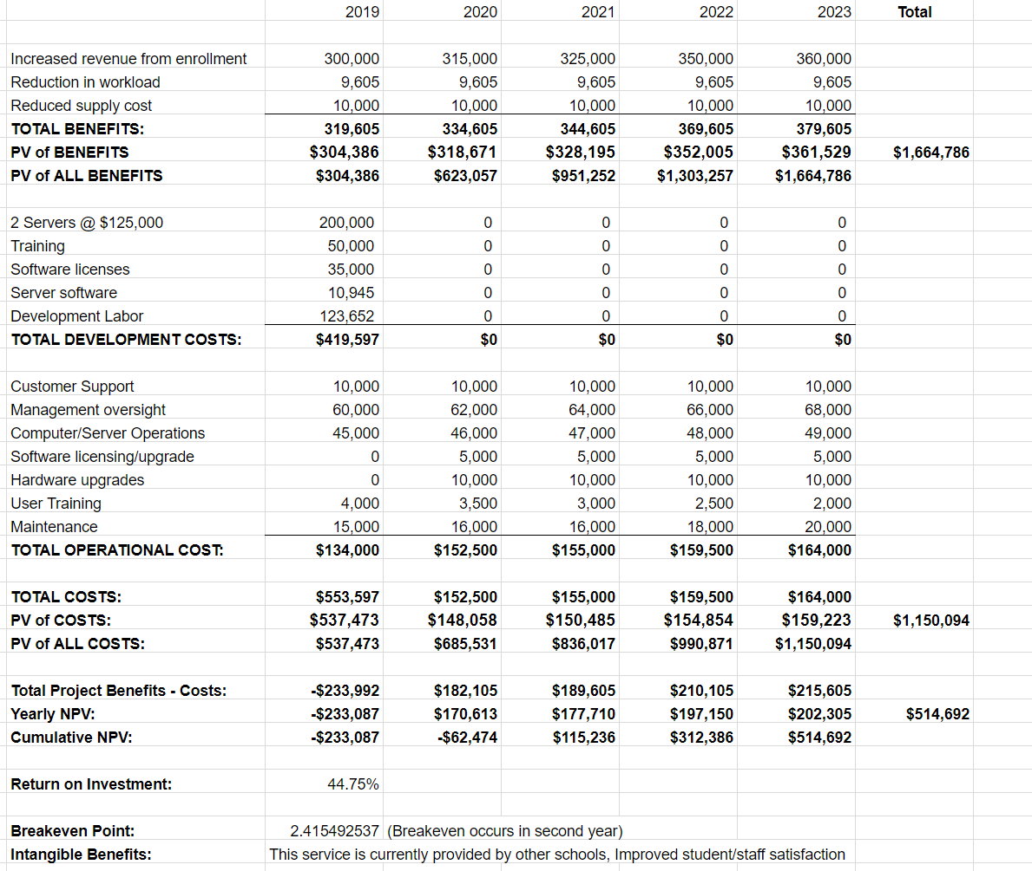
Phase 2: Cost-Benefit Analysis

Slide 8
Phase 3
Developed & Implemented By

Slide 9
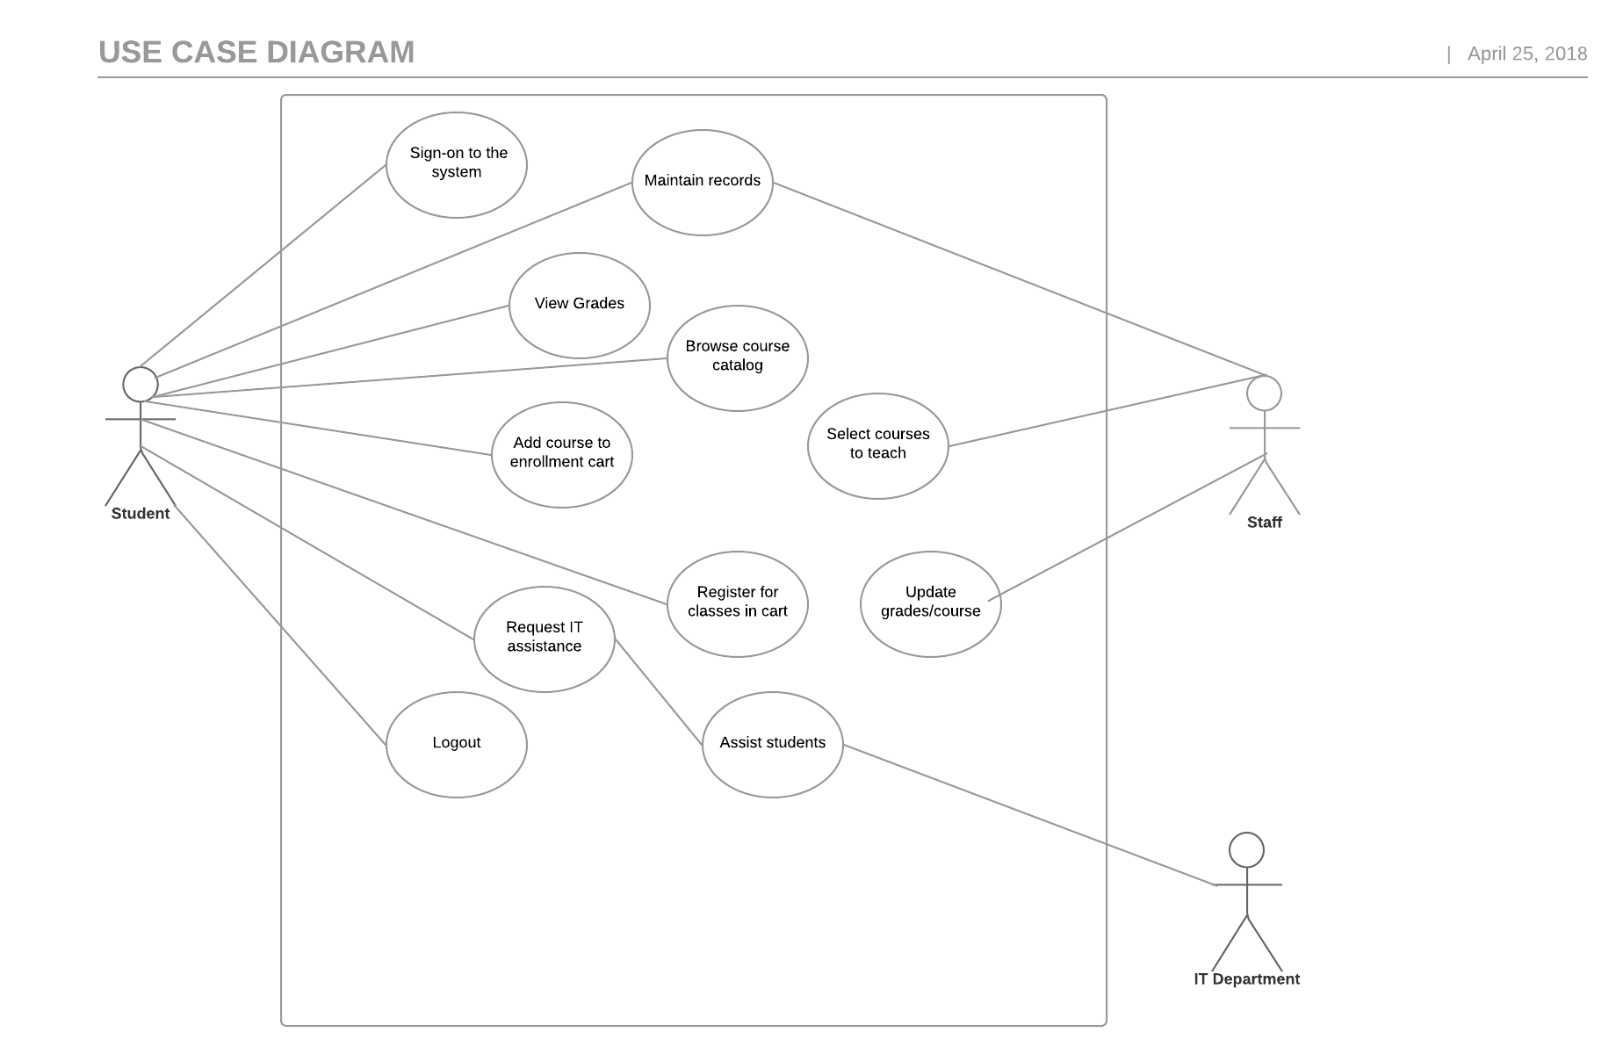
Phase 3: Use Case Diagram

Slide 10
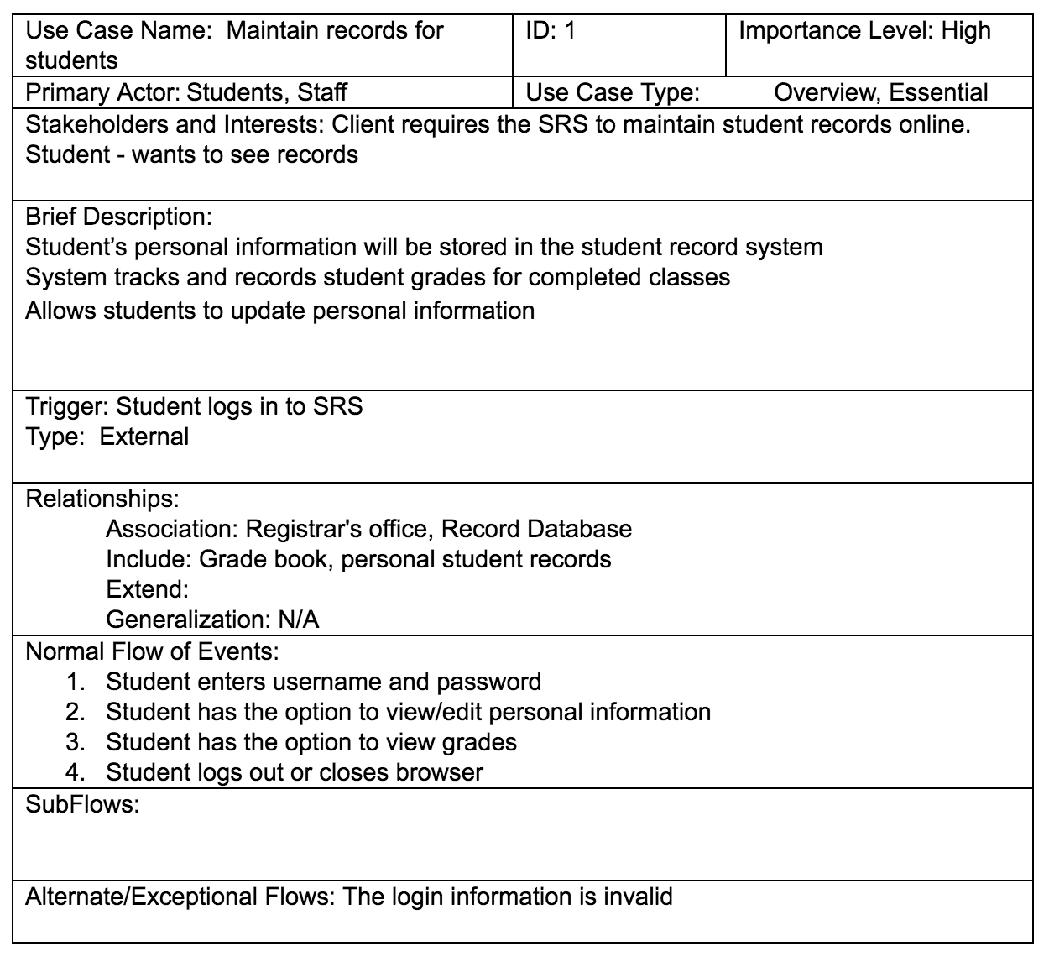
Phase 3: Use Case Description - SRS

Slide 11
Phase 4
Developed & Implemented By

Slide 12
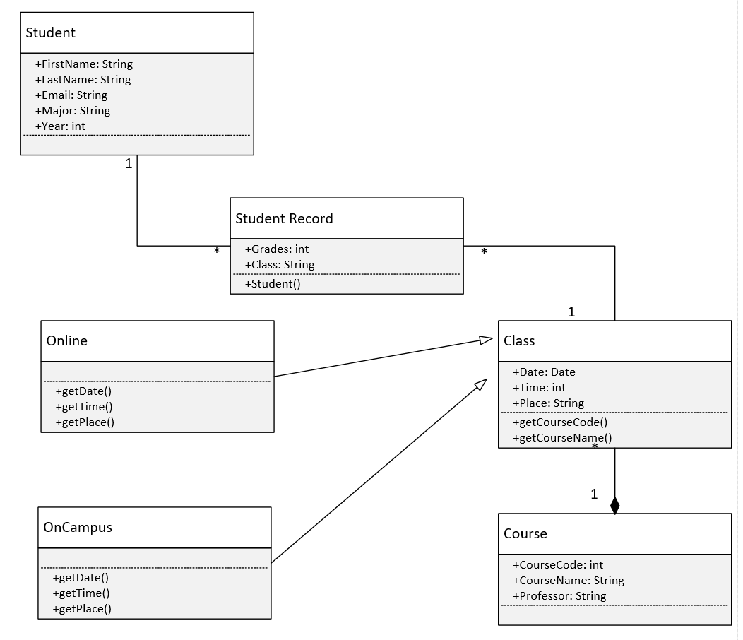
Phase 4: Class UML Diagram

Slide 13
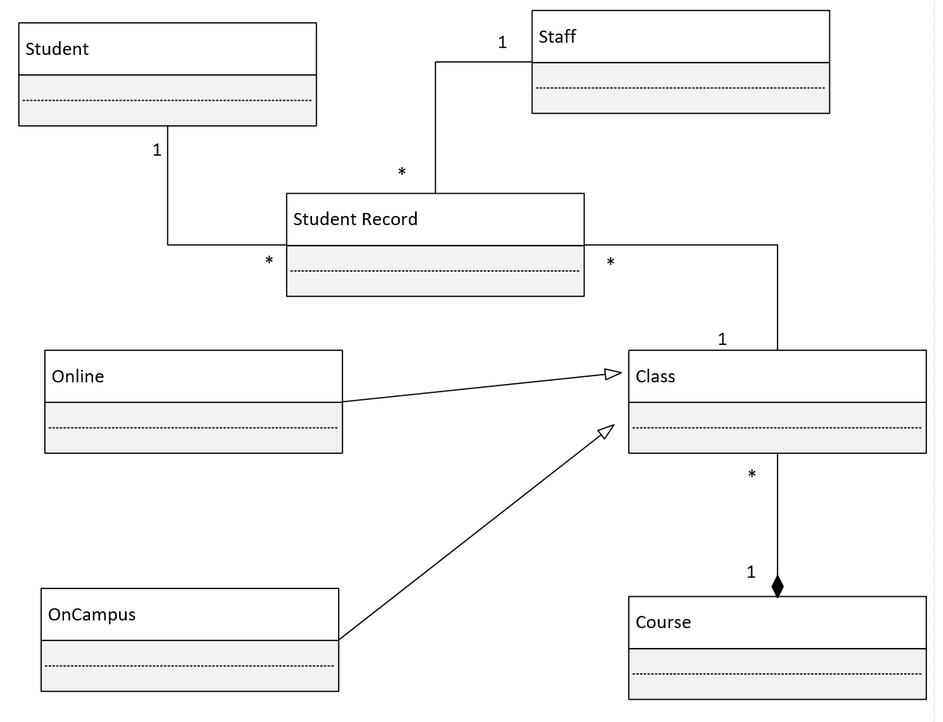
Phase 4: Class Diagram

Slide 14
Phase 5
Developed & Implemented By

Slide 15
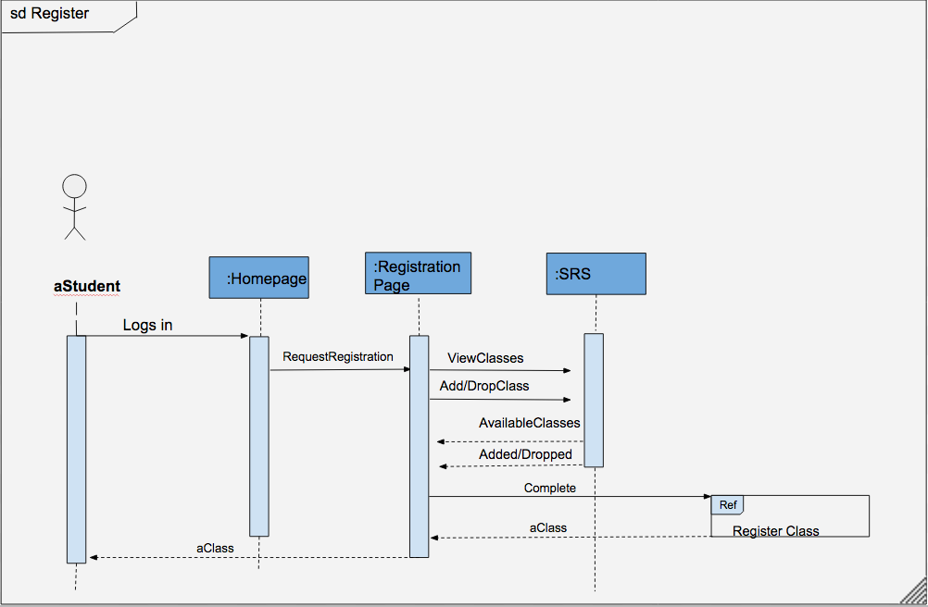
Phase 5: Sequence Diagram

Slide 16
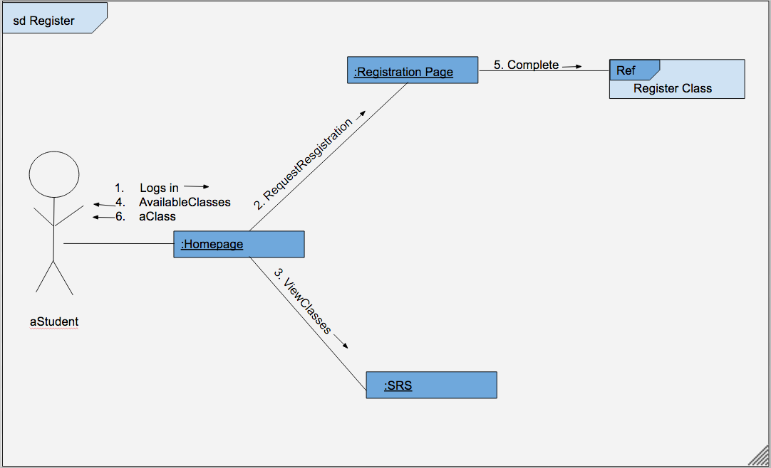
Phase 5: Communication Diagram

Slide 17
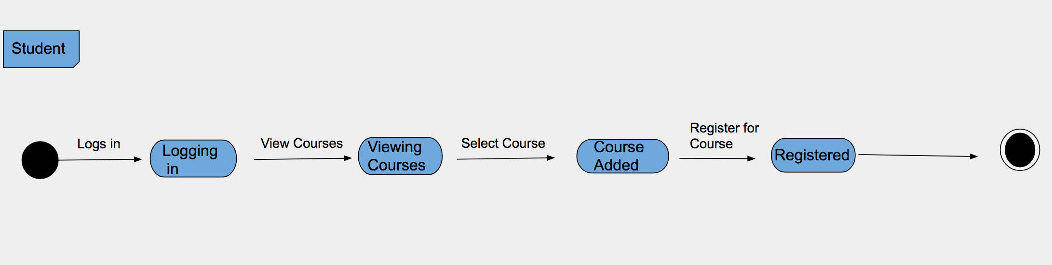
Phase 5: Object State Diagram

Slide 18
Phase 6
Developed & Implemented By

Slide 19
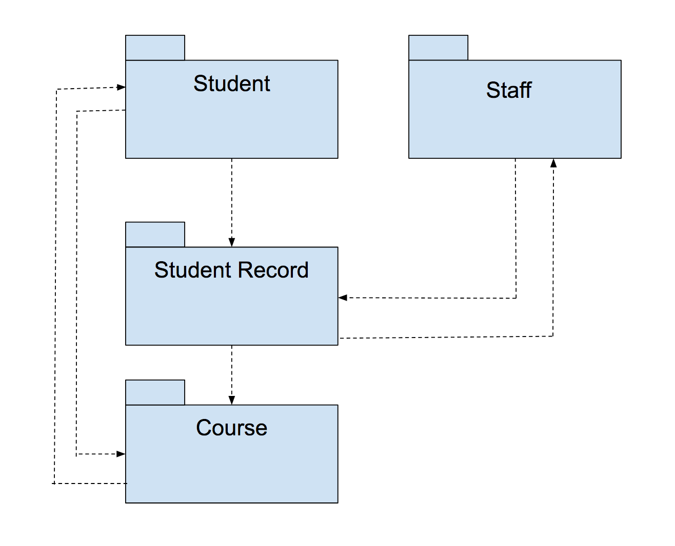
Phase 6: Package Diagram

Slide 20
Phase 7
Developed & Implemented By

Slide 21
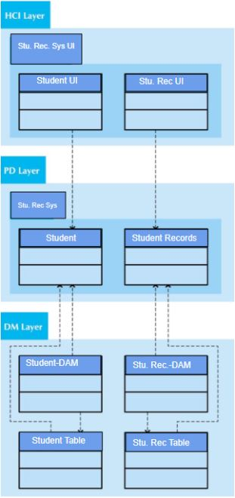
Phase 7: HCI Layer, PD Layer, DM Layer

Slide 22
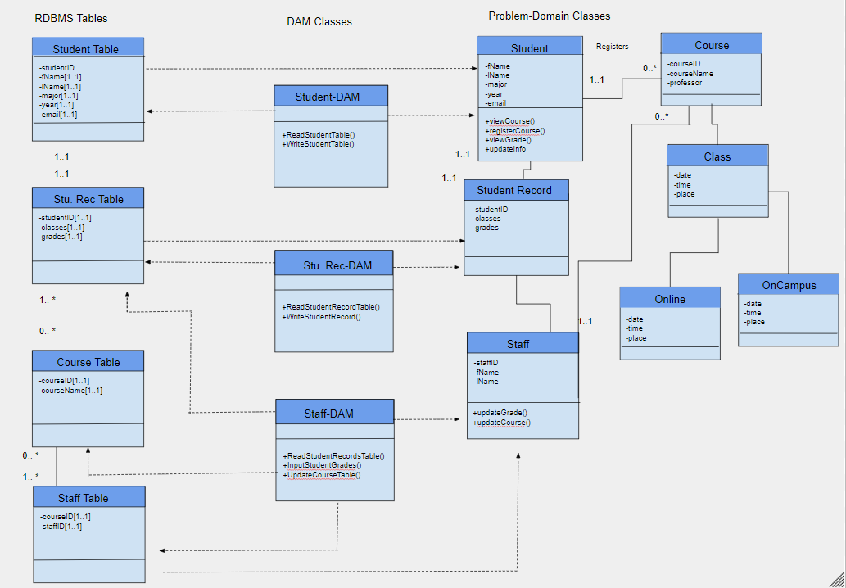
Phase 7: Problem Domain

Slide 23
Phase 8
Developed & Implemented By

Slide 24
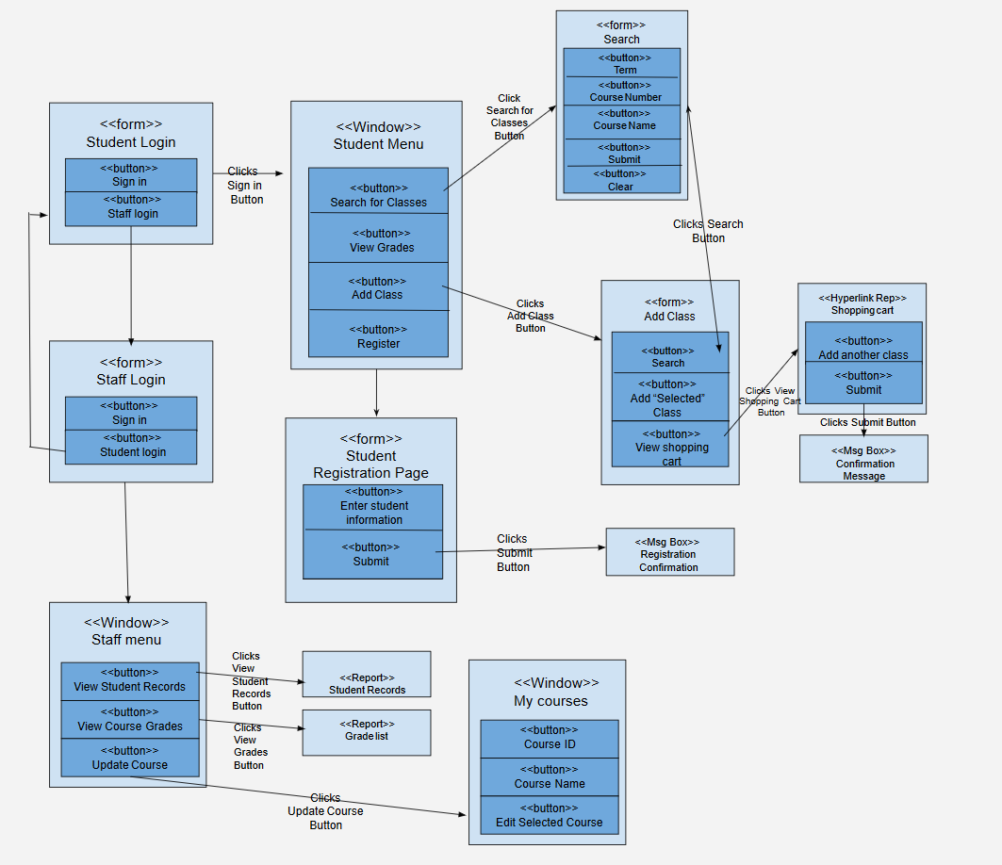
Phase 8: Windows Navigation Diagram

Slide 25
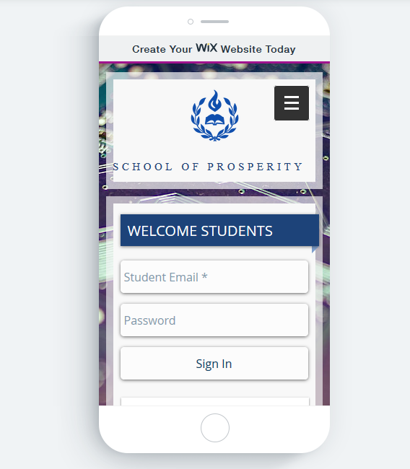
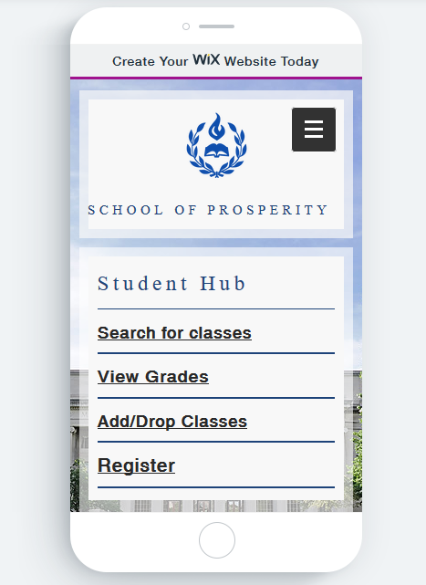
Phase 8: Mobile Interface

Slide 26
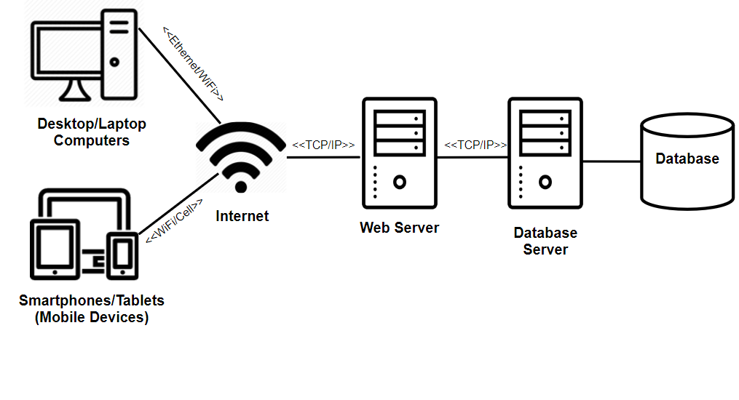
Phase 8: Deployment Diagram

Slide 27
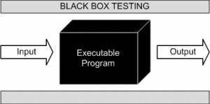
Phase 8: Test Plan
Unit Tests - Black Box Testing
Integration Tests
User interface testing
Use Case Testing
Interaction Testing
System Interface Testing
System Tests
Acceptance Tests
Alpha Testing
Beta Testing
Black Box Testing

Slide 28
Phase 8: Conversion Strategy
CONVERSION PLAN:
Style
Direct Conversion:
Convert directly from the paper system, to the digital system.
Implemented soon as possible.
Length (6 months starting Summer)
Location
Simultaneous Conversion:
Installed at one location, since only the School of Prosperity is involved.
Module
Whole-System Conversion:
Simple and easy to understand.
Entire system is installed at one time.
Things to do:
Install and test required hardware.
Install and test the software after.
Convert the written data onto the software, to convert it digitally.

Slide 29
Phase 8: Post-Implementation Activities
System Support:
Online support for ease of access (FAQ).
Help desk via phone call or in person
Give clients assistance when they need it.
System Maintenance:
Maintenance will occur every month on the first Saturday, 2-4 hours starting at 6AM.
Problem Reports
Change Request
Assess and Review Project after installation and within 3 Months after.
Solve any further issues/bugs.
Assess anything that can be improved.
Review the performance of the project.

